Slide 1
Coffee Sales Dashboard
Data Analyst Internship – Task 3
By Aryan Raghuwanshi

Slide 2
Objective of the Dashboard
To design an interactive and insightful business dashboard using Power BI.
The goal is to showcase key business metrics (KPIs) like Sales, Profit, and Growth in a visual and easy-to-understand format for stakeholders.

Slide 3
Key Performance Indicators (KPIs)
• Total Sales
• Max Amount Spent
• Sales by Coffee type
• Min Amount spent
Avg Amount Spent
• Category-wise Sales

Slide 4
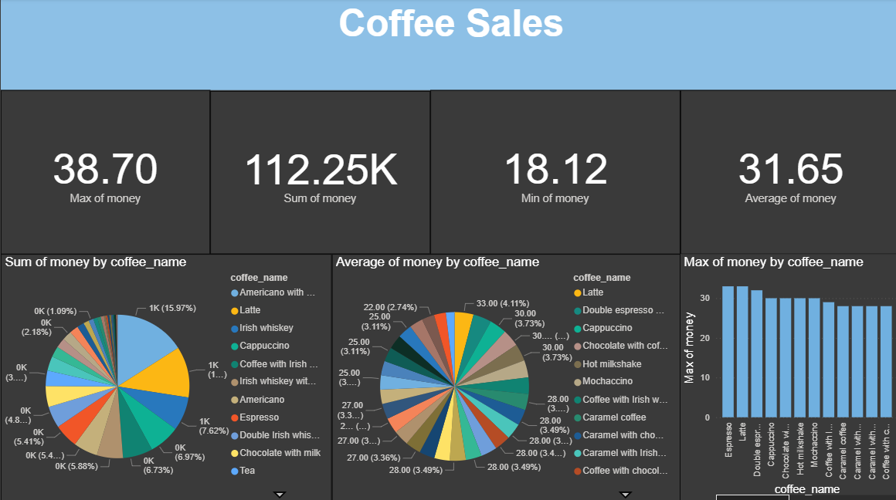
Dashboard Overview

Slide 5
Insights and Observations
• The Type with the highest sales is identified clearly.
• Some categories perform significantly better .
• Cards provide a quick summary of business metrics.

